Slide 1
Customer Analysis
ANZ Gig Incubation Program 2021
Gaurav Diwan
Data Scientist at Bank X

Slide 2
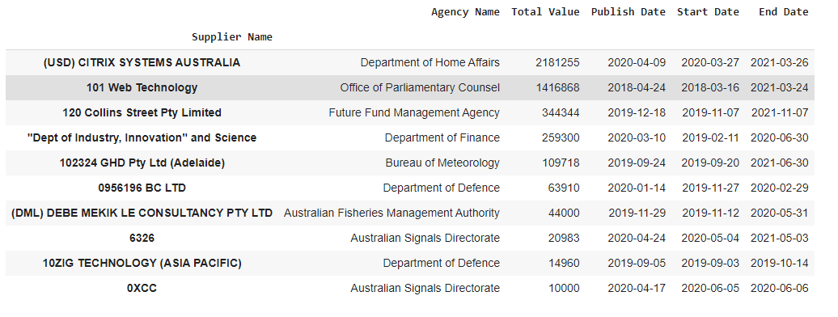
Top 10 Customers
Bank should be providing services to the customers that are providing the most business revenue.
Results analyzed over last 10 years from 2010 to 2020.
Total values calculated is the sum of the Initial values decided and the Amendment value added, if any.

Slide 3
Suggested Locations for Bank X
Top priority on providing timely services to the highly valuable customers.
Suburbs and locations near to the North Sydney, Oxley, Melbourne and Canberra will be a good place to setup the office as high majority of the top value clients reside in these locations.
To overcome cost, it is suggested to target nearby suburbs for the office areas and not the CBD to provide seamless services to their valued customers.

Slide 4
ML use case
Problem -> Which agencies are likely to provide high values in the future?
Proposed Solution -> Grouping agencies/suppliers into different clusters of High valued clients, Average valued and Low valued clients. In addition, classification can be used to check which cluster the client will be falling to in the future to forecast the value insight.
Machine Learning Algorithm used -> K-means clustering algorithm and SVM classification model.
Pros -> We are able to predict the high value clients and provide service accordingly.
Cons -> Low value clients get ignored during new policy making strategies based on above results.
Implementation -> https://github.com/gauravdiwan21/ANZ-Assessment

Slide 5
Thank you

